Slide 1
EC544 Team 1 – Challenge 3 Remote Access
Abdulaziz Alhassan, Damini Ashok Chopra, Konstantino Sparakis,
Xinzhu Xu, Wenyng Zhang

Slide 2
Design Decisions
Dynamic DNS and Port Forwarding techniques are implemented for Remote Access.
The Dynamic DNS is implemented at site www.noip.com (a free DDNS site).
IP address of Laptop is sent and stored on this site.
Phone as a TCP client, Laptop as a TCP sever
Android app sends on or off command for specific led

Slide 3
Technologies
Dynamic DNS
Port Forwarding
SeverSocket in java
Buffering
Android Java API

Slide 4
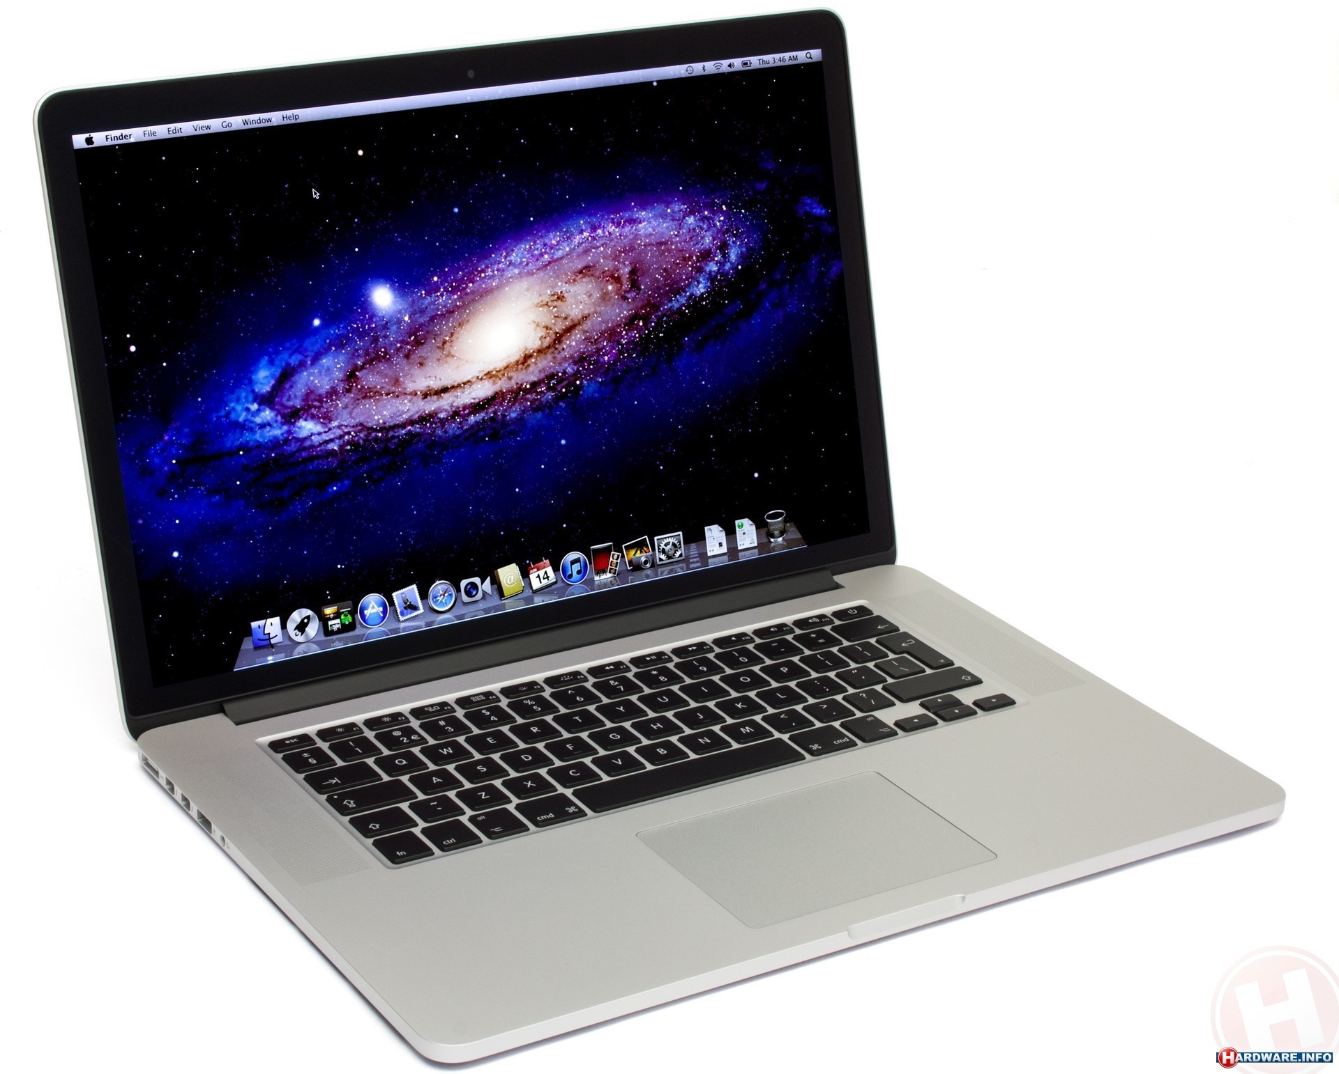


Data Flow
.
Laptop
.
Phone
DDNS
TCP (Port 5000)

Slide 5
Challenges
Setup DNS

